Slide 1

SECURITY VULNERABILITIES AND THEIR RELATIVE IMPORTANCE TO THE BANKING INDUSTRY.
Presentation by Toby Killen in submission for COM117 – Software Systems, coursework assignment 2.

Slide 2
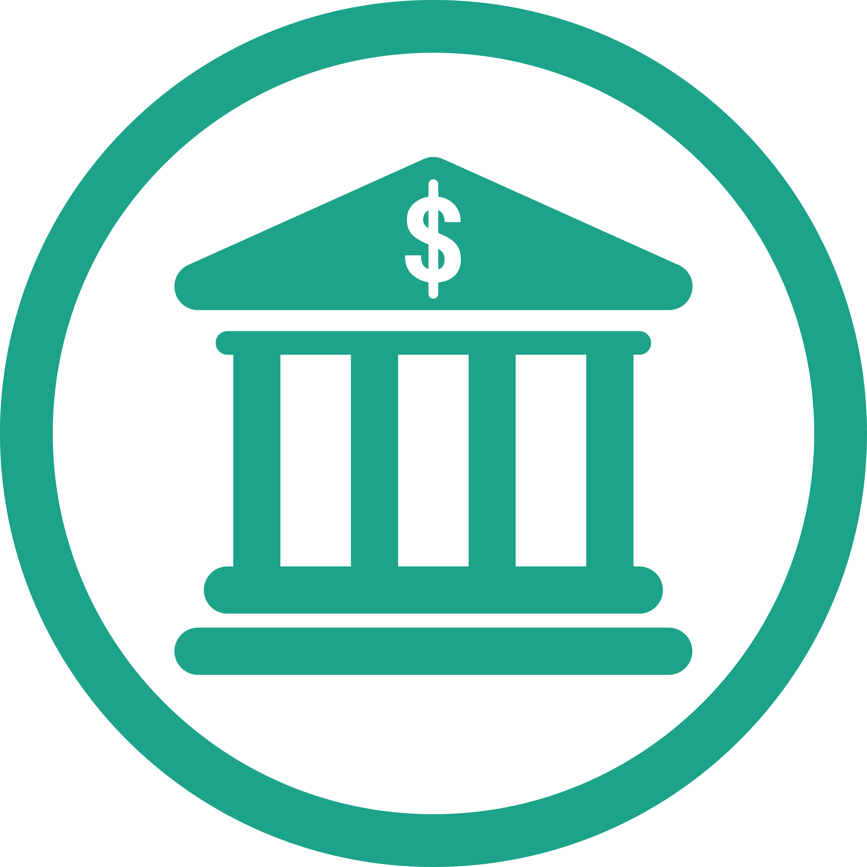
Introduction
Within this presentation I will be discussing relevant security issues, flaws and vulnerabilities within the banking industry. I will be addressing some key aspects within security vulnerabilities and their effects on the banking industry. I will also be identifying security features that a network should process in order to support administrative, technical staff and managers. Consideration will also be given to current research development in areas where available. I will also be touching on relevant social, legal and ethical issues regarding the banking industry.

Slide 3
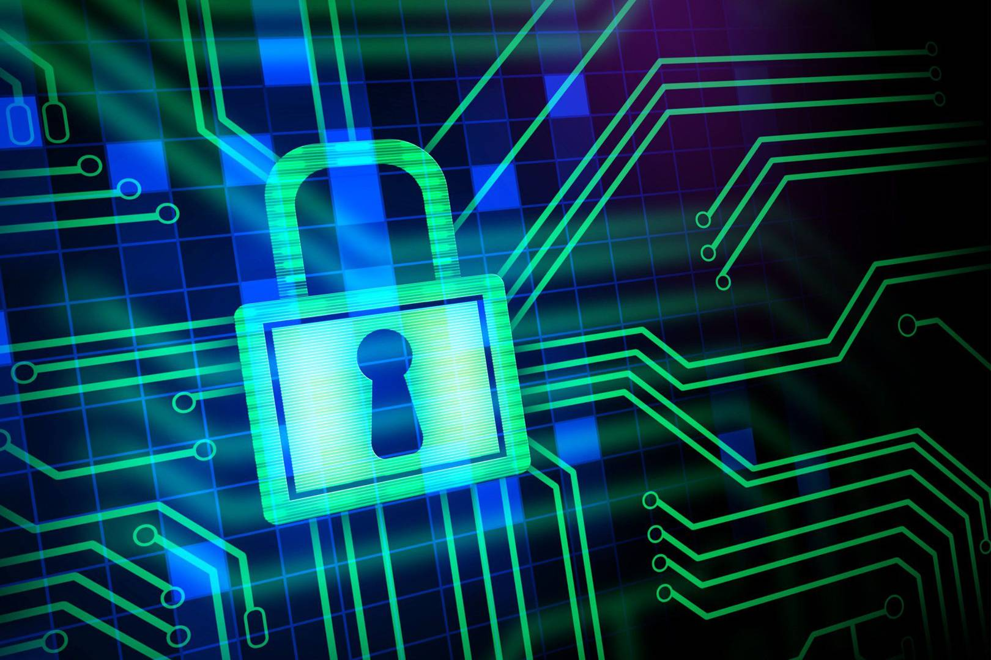
Encryption
What is encryption? Encryption is process of encoding data given by a user or before it is entered into a database, making it unintelligible and scrambled from the original raw data. A lot of cases, encryption is also paired with an encryption key. Who ever has this key are able to see the encrypted data.
Encryption is a bunch of algorithms designed to be unique and used to scramble and unscramble information given to the algorithm. The person encrypting will generate and duplicate a key and pass them on to relevant people who need the key other know as “public-key cryptography”

Slide 4
Encryption (Continued)
All banks today use encryptions to protect their customers. Banks use what is called bank level encryption protecting the bank and the customs assets. So how safe is bank encryption? Bank’s make sure every day that data and information is not compromised. A security breach for a bank can lead to detrimental consequences such as losing customers, massive data breach linking emails, card numbers and passwords for password dictionaries.
Banks now, implement a level of encryption over all actions linked to files and transactions preventing hackers accessing and viewing the information.
The standard bank level of encryption used today is 256-Bit AES, or advanced encryption standard.
What does 256-bit Encryption Mean? 256-bit encryption 256-bit refers to the exponent that represents the incredibly vast possible encryption combinations that your data has been coded with. This means that there is an indescribable number of possible encryption combinations that a hacker would need to go through in order to crack the code.
Data encryption is essential for true security because we live in a time where data breaches are main steam news and it have never been more important until now to implemented to prevent such occurrences. They use 256-bit encryption as a standard to protect themselves and their customers from identify and financial threats.

Slide 5
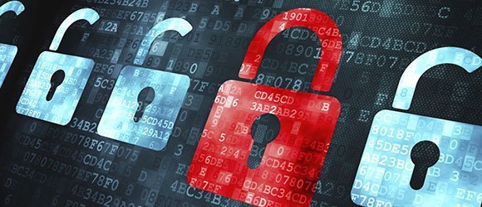
Encryption (Continued)
Bank’s also use software firewalls as a first line of defence against unauthorised access to their systems, continuality updating their software to attempt to remain one step ahead of the hackers. Furthermore these security measures, banks also implement a certain level of encryption over all of your digital files and online transactions.
So why use encryption at all within a bank? Encryption is used to hide information into unreadable forms of data to protect meaning and context of the lettering. So encryption protects form a man in the middle attack from being carried out preventing data send across the network like passwords and login credentials so to prevent from hackers gaining these information, encryption is used to prevent this and the more advanced encryption such as 256-bit encryption like I mentioned before is used.

Slide 6
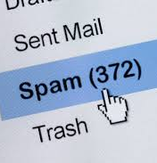
Email Spamming
What is email spamming? Email spamming also known as junk email is the act of sending unsolicited messages in bulk by email or “spamming”. Yes it is effective for marketing purposes but it is also malicious. Spambot’s designed to flood the index of the internet for email addresses and send “junk’ mail to those emails found.
Email spam comes in different forms, the most common being advertisement of scams or somewhat legal business schemes. Spam is commonly used to conduct email fraud. The advance with a fee scam is a well known example when a user receives an email with an offer within that promotes a reward at the end but to get to the end the user is prompted to pay money either in bank transfer or bitcoin to hide their identity. Once paid the scammer will either push for more funds or stop responding.

Slide 7
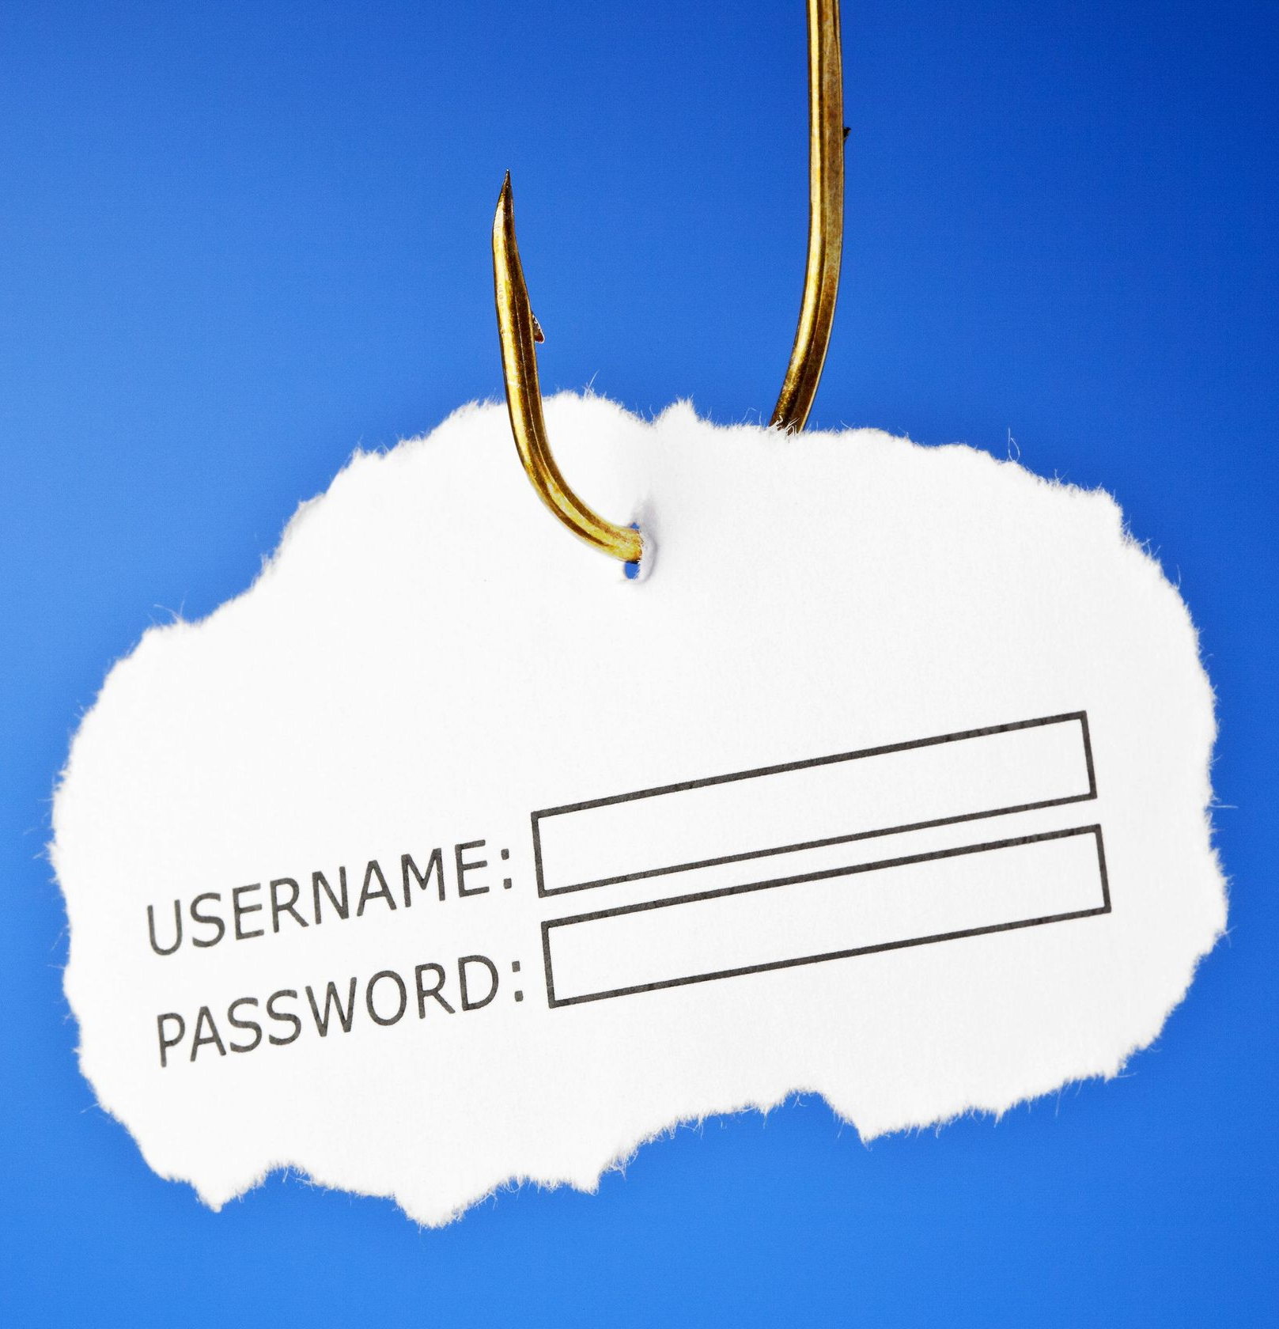
Email Spamming (Continued)
How can email spamming be a compromise for banking? Email spamming is a very effective method of sending a payload to a potential victim injecting a RAT payload for remote connection and control over the victims PC. These emails are designed to be disguised as official compunctions from the bank, online payment processors like PayPal. These emails usually redirect recipients to a fake version of the organization’s website, where the user is asked to provide login details and credit card information where is it is then sent to the hacker or the hackers server as raw viewable information to be used to gain unauthorized access to computer systems.

Slide 8
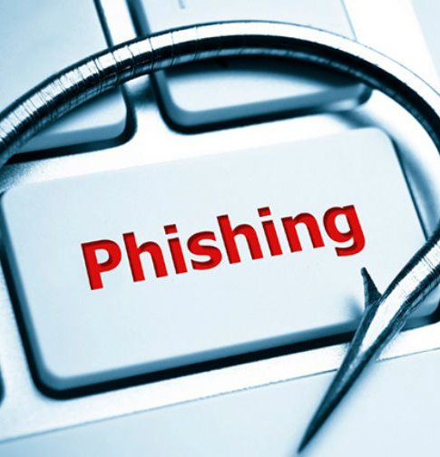
Email Spamming (Continued)
There are different spamming methods such as “botnets” and “Snowshoe”. Botnets allow spammers to use command and control servers to both harvest email addresses and distribute spam. Snowshoe spam is the technique of using a wide range of IP addresses with neutral reputations to distribute spam widely.
Another method spammer use is blank email spam. This is sending an email with a blank body and subject line. The technique could be used in a direct harvest, seeing validation from a server to develop a legitimate distribution list by identifying invalid bounced addresses. This attack, the spammer can hide certain viruses and worms that can be spread through HTML code which is embedded into the code.

Slide 9
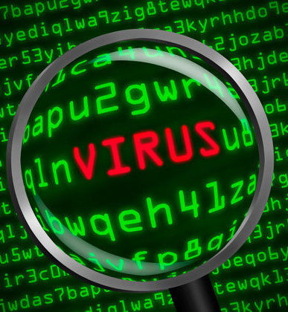
Virus Threats & Countermeasures
Virus threats are malicious program that self replicates by copying it self to another program or into executable code or documents. Hackers design computer viruses with malicious intent and pre on online users by tricking them other known as social engineering attacks.
There are several different types of viruses used to exploit computer systems for malicious intent deigned for computer exploitation.
A famous type of virus that hit the news in the last few years is a ransomware type of virus called “WannaCry”. WannaCry is a malicious virus which encrypts all accessible files, folder, photos etc. it can see within the computer. It encrypts using a private key using a really strong encryption process like AES 256-bit encryption. The files end up encrypted but the user can not decrypt their files without the key and the hacker will refuse to give them the encryption key without paying a ransom, hence the name ransomware.

Slide 10
Virus Threats & Countermeasures (Continued)
If a bank’s database fell victim of ransomware, it would cause havoc to the bank and also customers becoming victims of a cyber attack. I will discuss what are the malware-viruses, how they work, and what can you do to prevent the malware-virus from infecting your computer.
Some of the common online banking malware viruses are Zeus, Spyeye and zitmo which are all examples of financial trojan malware viruses. Instead of attacking the banks online banking servers, which are equipped with multiple layers of security, these malware-viruses attack the customer directly.

Slide 11
Virus Threats & Countermeasures (Continued)
When a computer is infected with any of these trojans which have mentioned before, it waits for a person to long onto a list of targeted banks e.g. Barclays that are build into the virus. This all happens in the background and the user doesn’t realize it is happening until it is too late. The user is presented with a fake copy of the bank using a spoofed website copier such as the SET toolkit which is found easily on most pen testing distros of Linux such as KALI.
The easiest way to protect yourself form this attack is before typing anything in, have a quick glance at your connection to ensure you are using HTTPS and not an unsecure connection like HTTP.

Slide 12
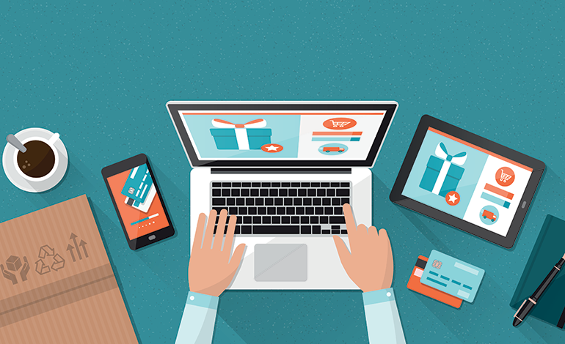
Net Etiquette
Net Etiquette are rules that have been developed over the years regarding communication and interaction of the internet. An example of net etiquette would be before posting a question on a forms like reddit to ensure your question makes sense and is relevant.
These rules are advised to prevent the user from mistakes that can lead to negative impacts on them personally. The following slide will cover a few rules.

Slide 13
Net Etiquette (Continued)
Post Sensibly and Responsibly
Anything you post on the internet is permanent. It cannot be undone or removed in most cases. Several copies of a single piece of content are made automatically within minutes. This includes an index copy with search engines, website cache and downloads of a file by some person. Avoid posting information or private content even if it’s just for fun as it may lead to embarrassment later. Sending data in plain text over email or chat messenger can also lead to hacking attempts.
A possible solution would be to make sure you read over the stuff you write and think twice about posting anything anywhere.

Slide 14
Net Etiquette (Continued)
Shop only from SSL-Secured Websites
HTTPS is a protocol of secured communication over the internet. It can be implemented on e-commerce websites by installing a SSL certificate. This ensures that customer-entered information like credit card details and banking information are transferred securely. Ensure that address bar of your web browser turns green while making transactions on any website. However, This doesn’t ensure security from fraud as SSL just ensures that the data communication between the user and servers is encrypted and secure. However, the probability of getting scammed is reduced because the process of certification requires another layer of validation.
A solution for this would be get into a habit of looking up at your browser to ensure that you have a secure connection between you and the servers.

Slide 15
Net Etiquette (Continued)
Use a Secure Password
This advice given often and is strongly advised and enforced by some bowers like Google Chrome. As tech enthusiast alike we understand the importance of having a strong and secure password, we still don’t use one. The reason behind this is carelessness. People might say that it is not possible to have a unique password for all the online accounts they have signed up for.
A Possible Solution for this would be
You can make use of a Password Manager like Dash lane. It is not just for storing passwords, but also for generating a unique and secure string for each service you register online. It can also automatically fill in the password in one click whenever it encounters a login form. This reduces the effort of typing and risk of getting the keyboard input strokes recorded by malware.

Slide 16
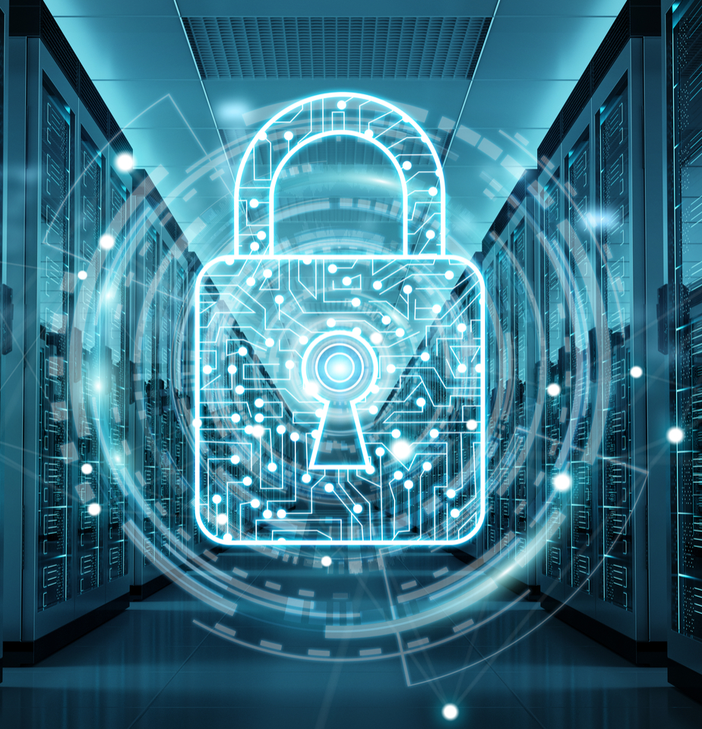
Firewalls
A firewall is a network security system which controls and monitors both incoming and outgoing network traffic based on pre user defined security rules. A wall enforces a barrier between a trusted internal network (A Bank for example) and a untrusted external network (The Internet for example).

Slide 17
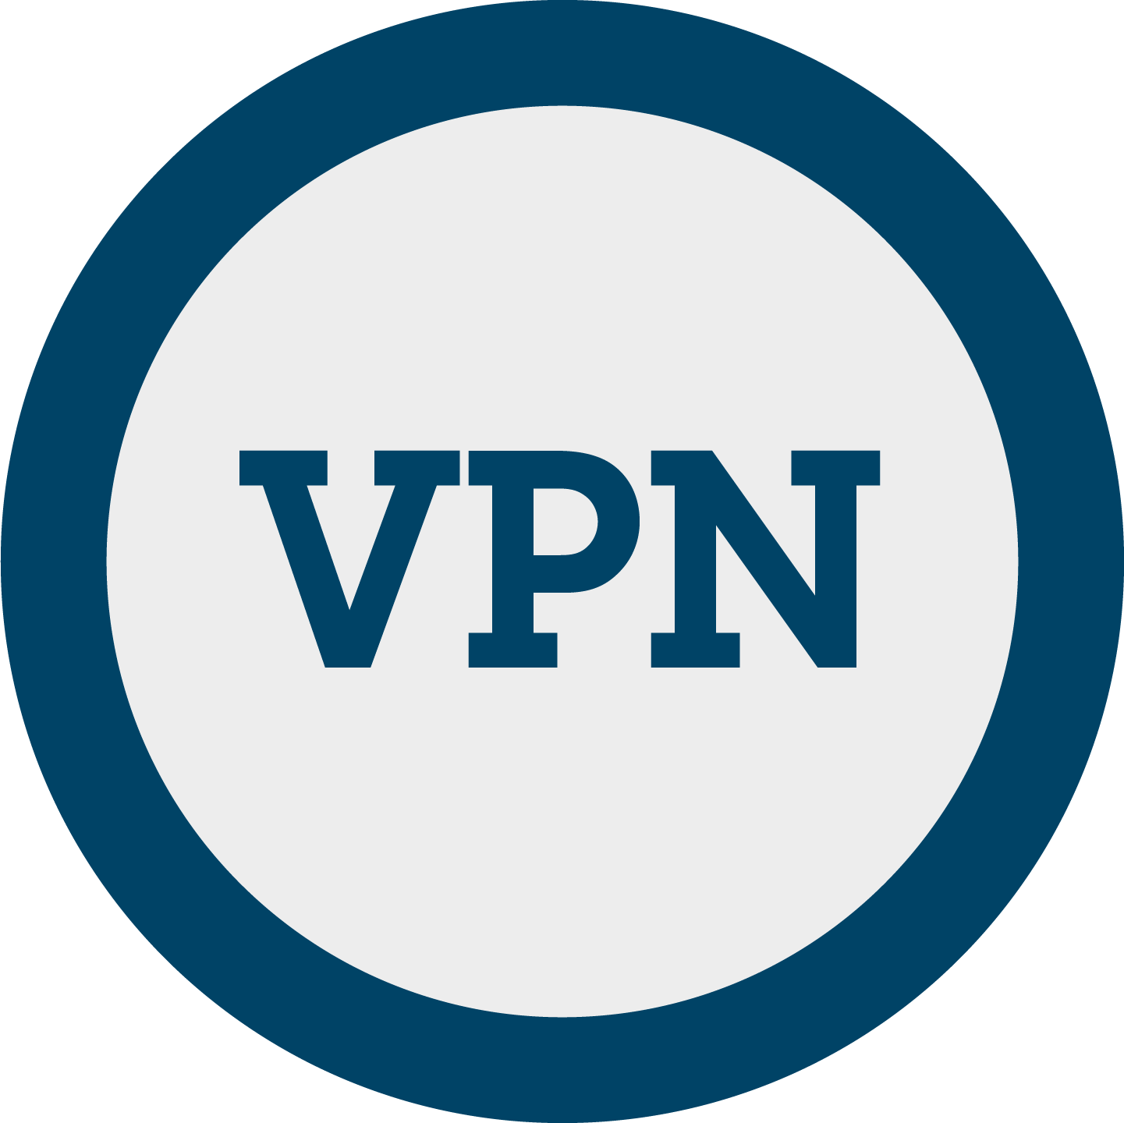
VPN
A VPN or virtual private network extents a private network across a public network allowing users to send a receive data across shared or public network as if they were directly connected to that network.
Whilst using a VPN it comes with some advantages and disadvantages. Advantages are that it Allows you to be at home and access your company's computers in the same way, as if you were sitting at work. Almost impossible for someone to tap or interfere with data in the VPN tunnel. If you have VPN client software on a laptop, you can connect to your company from anywhere in the world.
Disadvantages being that The company whose network you connect to may require you to follow the company's own policies on your home computers. Setup is more complicated than less secure methods. VPN works across different manufacturers' equipment

Slide 18
VPN (Continued)
Known Vulnerabilities
Some VPN applications that has developed for business usage improperly store authentication tokens and session cookies on a user’s computer. These aren’t your traditional consumer VPN apps used to protect your privacy, but enterprise VPN applications designed to allow remote workers to access resources on a company’s network.
The apps generate tokens from a user’s password and are stored on their computer to keep the user logged in without having to reenter their password every time. But if stolen, these tokens can allow access to that user’s account without needing their password.
But with access to a user’s computer such as through malware an attacker could steal those tokens and use them to gain access to a company’s network with the same level of access as the user. That includes company apps, systems and data.

Slide 19
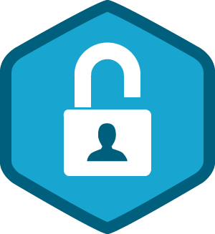
Authentication
Authentication is the process of confirming the data being correct, accurate and factful. Authentication technology provides access control for systems by checking to see if a user credentials match credentials in a database pre authorized by the admin or an authentication server.
So how is authentication used? Authentication is used mostly with human to human interactions outside of guest accounts, auto logged in accounts and kiosk computers. Normally a user has to enter a username and a password to gain access to a system. User authentication authorizes human to machine interactions in applications and operating systems over both wired and wireless networks to enable access to networked and internet connected systems, applications and physical resources. Many companies use authentication to validate users who log into their websites. Without the right security measures, user data, such as credit and debit card numbers could get into the hands of hackers.
Banks use authentication allowing to control which users have access to networks and resources, as well as to identify and control which machines and servers have access. Companies also use authentication to allow for remote connection for employees to securely access their applications and networks.

Slide 20
Authentication (Continued)
So how does authentication work? During authentication, credentials are provided by the user input and then is compared to those stored in a database of pre authorized users either on the local operating system or through an authentication server. Usernames, UserIDs and passwords are not stored in raw format as they are on the database they are encrypted before stored using a one way hash function then stored on the database allowing for an extra level of protection on the database incase of a data breach. Usually authentication was accomplished by the system or resources being accessed. An example of this would be the following: a server would authenticate users using its own password system, implemented locally, using login IDs and passwords.
Some disadvantages with authentication are that web's application protocols such as HTTP and HTTPS, are stateless, meaning that strict authentication would require end users reauthenticate each time they access a resource using HTTPS. Instead of asking for a user name and password every single time the user wants to log in, the application or website uses a protected systems often rely on token-based authentication, in which authentication is performed once at the start of a session. The authenticating system issues a signed authentication token to the end-user application, and that token is appended to every request from the client.
Entity authentication for systems and processes can be carried out using machine credentials that work like a user's ID and password, except the credentials are submitted automatically by the device in question. They may also use digital certificates that were issued and verified by a certificate authority as part of a public key infrastructure to authenticate an identity while exchanging information over the internet.

Slide 21
Authentication (Continued)
There are different types of authentication. Single factor and multifactor authentication are examples. Single factor authentication is the basic form of the methods which a person matches one credential to verify himself or herself online. The most popular example of this authentication method would be a password to a username. Most verification today uses this method. Multifactor on the other hand uses the combination of something you know, something you have and something you are. Two factor is a “subset” of multi factor.
What is two factor authentication? Two factor uses the same combination of username and password but with the additional question of being asked to verify the person in question by using something they own such as a mobile device. This method is used to confirm identify of the user accessing the system.
What are the Risks of Single-factor Authentication?
Single-factor Authentication is a excellent method of verity someone accessing a system or a network however comes with some negative side affects. Online sites already have their password database leaks and which allows hackers to use a password dictionary to brute force the login to gain entry. Whether it is just two factors, three or more. Multi factor authentication generally is a way to make an account near impossible to crack making it the mainstream method of authentication currently.

Slide 22
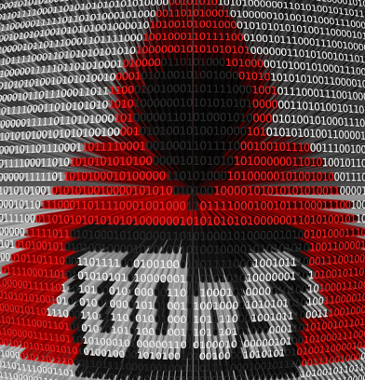
DDOS Protection
Distrusted denial of service attacks is one of the oldest known threats to target systems. This is a common problem and unfortunately there is no solution with 100% efficiency. DDOS attacks is where multiple computer systems from different locations attempt a request to the same server to a point where the server cant cope with the traffic and essentially crashes.
DDOS Mitigation is a set of techniques or tools for resisting or mitigating the impact of a distributed denial of service attacks on networks attached to the internet by protecting the target and relay networks.

Slide 23

Legal Issues for Banks
If a successful cyber attack was carried out on a banks website in a data dump, banks would have to pay out money to customers whom details having being stolen and any stolen money replaced back into their account.
In return this would cost the banks money to their profits and it can lead the bank being sued from the customer or other smaller business leading to a further loss of revenue. Also a bank’s site might be using copyright content, exposing the bank to a copyright infringement case against them again leading to a further loss in revenue.

Slide 24
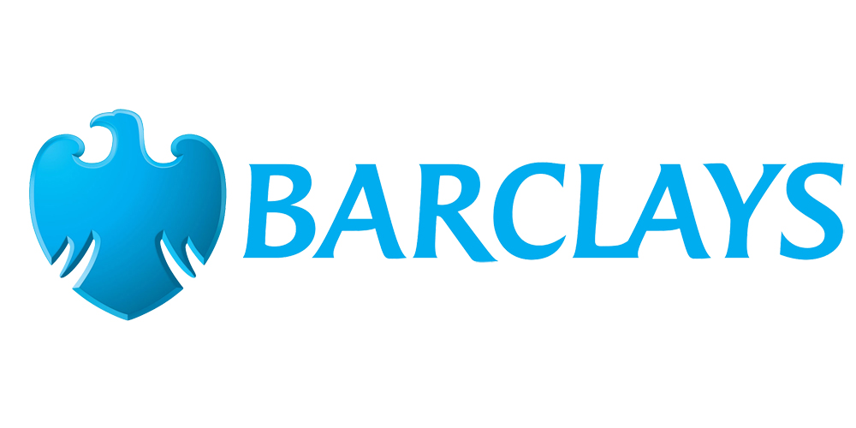
Social Issues for Banks
Social impacts on a bank from a cyber attack would result in the company's reputation being damaged from lack of trust from the customers to the bank thus customers changing banks to a more trust worthy bank. Rebuilding trust and reputation could be costly and time costuming but most importantly it can be lost within seconds resulting in lost revenue and customers.

Slide 25
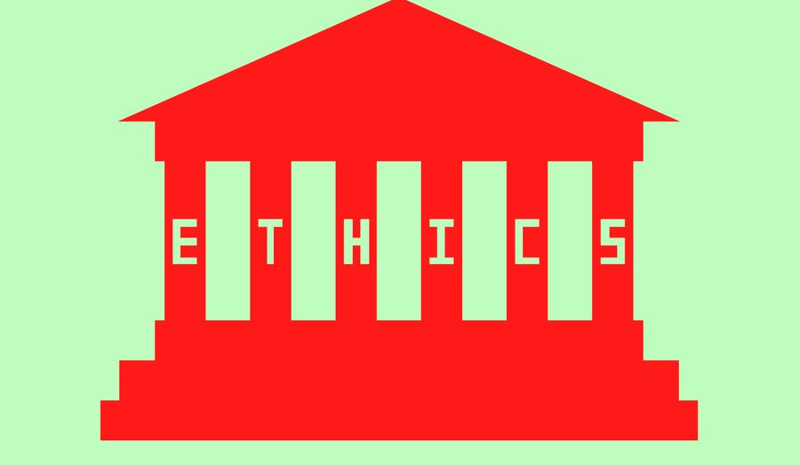
Ethical Issues for Banks
If a cyber attack is successful on a bank’s website in stealing details.
A customer’s privacy is invaded as their personal details could’ve been viewed or stolen ,the bank would’ve likely signed a GDPR agreement if operating in the UK to only use customer details for the purpose of the business. If details are stolen this could in fringe on this.
If the bank’s website keeps track of how visitors use a site through log files such as cookies. This can raise a lot of privacy concerns over how this data is being used. The tracking of user data through cookies will need to be disclosed on the website.

Slide 26
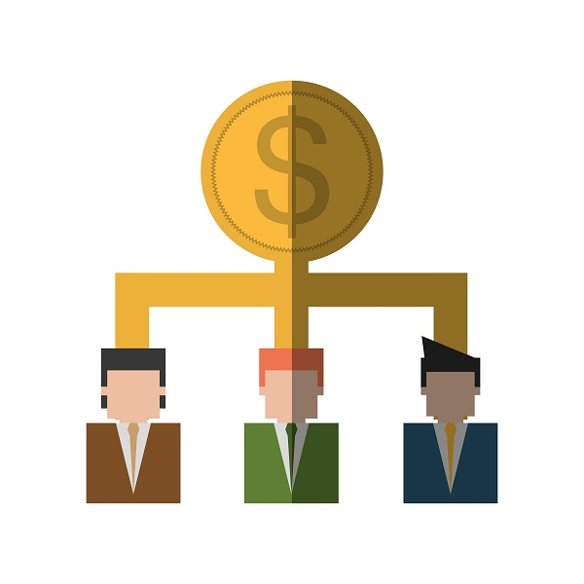
Effects on Share holders by cyber attacks.
Customer details could be stolen, leading to identity fraud and them losing money. Managers may get held up dealing with customers who are unaware of the dangers of using an unsecure network which leaves them with having less time to do their other tasks. Since they have to deal with customers who may have been a victim to their details being stolen. Due to an attacks customers might lose their money having the bank to replace their money thus reducing the share price value if any. Employees could be fooled into giving out administrative account details such as passwords if the hackers has infiltrated the bank’s internal network.

Slide 27
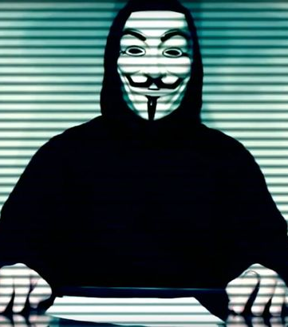
OTHER ISSUES RELEATED TO THE BANKING INDUSTRY

Slide 28
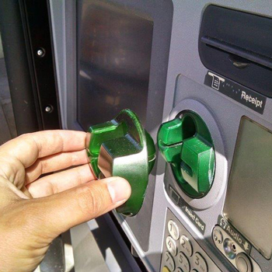
Fraud (Card Skimming)
What is card skimming? Card skimming is the process fraudsters use to copy or collect the victims credit or debt card bank details using what is called a “Skimmer”. The device then captures and then stores the details on the skimmer either locally or transmitting the information to a webserver where the information can viewed live. The ‘Skimming’ Process mainly takes place on an ATM machine. The easiest way to protect yourself from this type of attack is to cover your pin inputs and to use a credit card over a debt card, this way your bank covers you and it’s not your own money in the end.

Slide 29
References (Harvard)

Slide 30
References (Slide One)
Derek Crippin. (2019). How Safe is Bank-Level Encryption?. Available: https://www.alarmnewengland.com/blog/bank-level-encryption. Last accessed 17/04/19.
Margaret Rouse . (2017). Email Spam. Available: https://searchsecurity.techtarget.com/definition/spam. Last accessed 17/04/19.
Linda Rosencrance. (N/a ). What is Authentication? . Available: https://searchsecurity.techtarget.com/definition/authentication. Last accessed 17/04/19.
Steven Feltner. (2016). Single-factor Authentication (SFA) vs. Multi-factor Authentication (MFA). Available: https://blog.centrify.com/sfa-mfa-difference/. Last accessed 17/04/19.

Slide 31
References (Slide Two)
ETGEAR. (N/a ). What is VPN (Virtual Private Networking)?. Available: https://kb.netgear.com/1128/What-is-VPN-Virtual-Private-Networking. Last accessed 8/3/19
Verywell Mind. (2019). Ten Basic Rules of Netiquette or Internet Etiquette. [online] Available at: https://www.verywellmind.com/ten-rules-of-netiquette-22285 [Accessed 29 Apr. 2019].
wikiHow. (2019). How to Identify Email Spoofing. [online] Available at: https://www.wikihow.com/Identify-Email-Spoofing [Accessed 25 Apr. 2019]
En.wikipedia.org. (2019). Email spoofing. [online] Available at: https://en.wikipedia.org/wiki/Email_spoofing [Accessed 25 Apr. 2019].
Kaspersky.co.uk. (2019). What is a Trojan Virus?. [online] Available at: https://www.kaspersky.co.uk/resource-center/threats/trojans [Accessed 19 Apr. 2019].

